Slide 1
WELCOME
By:
Sajith Thomas, 180937
Sanjay Joshi, 180980
Mahesh, 180924
Thejas P C, 180985

Slide 2
SDM COLLEGE EXTRA-CURRICULAR ACTIVITY MANAGEMENT

Slide 3
Software requirement specification (srs)
This document includes the software requirement specification(SRS) of the system. The overall working of the system and the requirements of the system is understood by this document.
The extra curricular activities system is designed to help the college management to keep their students active in various extra curricular activities by participating in various individual and team events.
PURPOSE
The purpose of developing extra curricular activities system is to provide the platform for the students to participate in various individual and team events conducted by the college. This also helps the college management to make their students actively taking part in extra curricular activities along with the curriculum.
The team events will help the students to communicate with various other students of their department and the students will learn to cope up when they are in team. This also encourages the students to participate and motivates them into different fields other than only studies.

Slide 4
Project Scope and Product Features
The features of this system are as follows:
The student of the college must register to the system by entering all their details along with their course details. Once the student is registered to the website the student can login using their valid login credentials provided at the time of registration.
As the student login to the system they can view the various events in department wise or crosswise hosted by the staff. If the department wise event suits the student they can participate in those events. The student of one department cannot take part in the events of other departments. The student can either participate in the individual events or team events.
If the student wants to take part in the team event, then the student must create a team of 11 members and the token ID of all the team members must be entered only then the student can participate in the team event. In the individual event, the student can give the details of the event such as the scheduled date and the rules of the events and then the student can take part in the event.
On the schedule date of the event, the attendance will be taken by the staff to check the presence of all the participants. Once the event is complete, result of the event is published by the staff. The winners of first, second and third place are verified by the staff. The points for first, second and third place is different and is generated by the system. Results of all the other participants are generated automatically by the system.
The student can view the results of the events in which they have participated. If there is any mistake or error in the result, the student can raise the complaint report to the staff. The staff can view the mistake in the result and make the correction and republish the result. The staff can also reject complaint issue raised by the student.

Slide 5
Hardware interface
Operating system: Windows XP or higher
Hard disk: 40 GB hard disk
RAM: 1 GB RAM
Processor: Intel Pentium or above
3.1.3 Software interface
XAMPP 1.8.2
Apache server
PHP 5.4
MYSQL server 5.5
Adobe dreamweaver CS 6.0

Slide 6
User interface
This includes the users of the system. The system is used by three of its users.
Admin: The one who manages the entire website. Admin monitors all the activities that happens in the webpage and also monitors the student and staff accounts.
Staff: The staff is added by the admin. The staff must host the events and published results of the events. The staff must verify the first, second and third place results of the events.
Student: Student has to register to the website to use the system. Student can view the various events available for them under their course or department. If they wish to take part in any of the events they can participate in it.

Slide 7
Functional requirements
This includes the features of the various modules of the project.
Admin
Staff
Student

Slide 8
Admin is the one who manages the entire website and also has the full authority over all the activities of the extra curricular activities system. The admin monitors the other users of the website.
Settings module: This module is available only for the admin. The admin will add the point settings for different events. They we can add the details of the course that are available in the college. Here the admin will add the staff, the staff are the lecturers of the college who must host the events.
Next

Slide 9
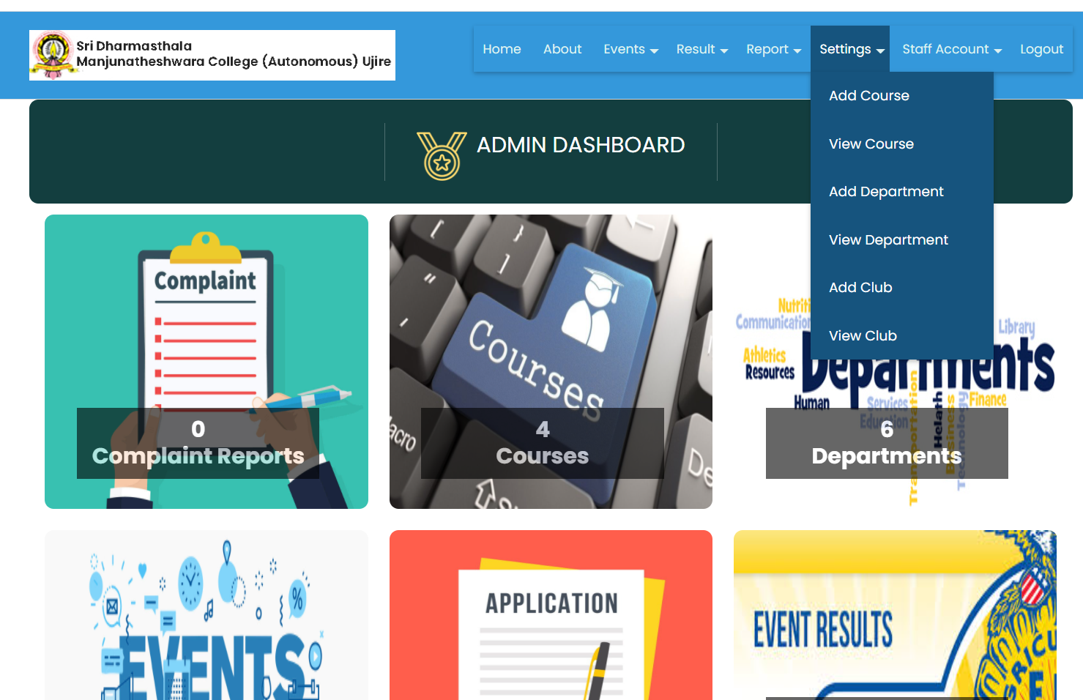
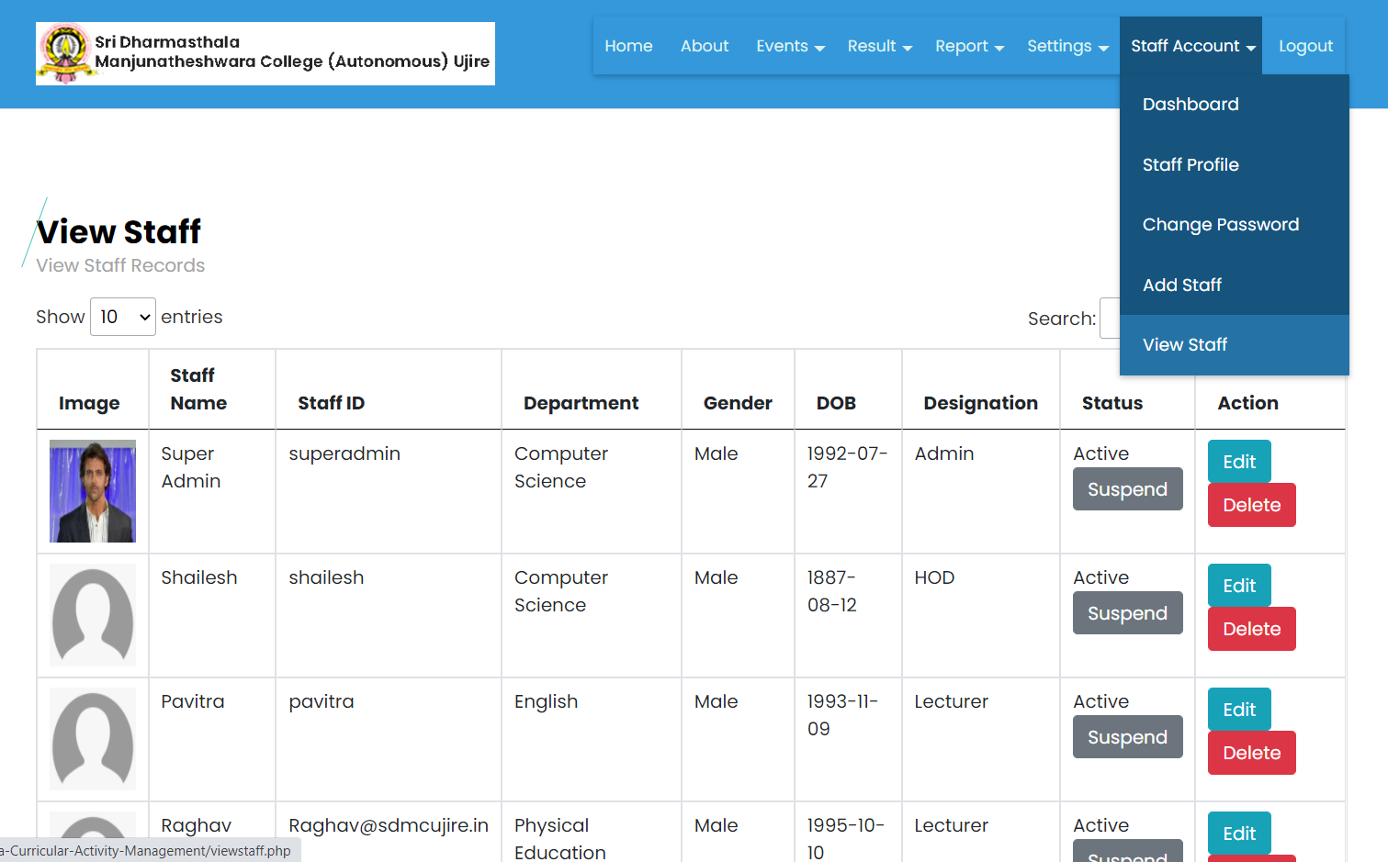
Back

Slide 10
Staff will be added by the admin. The staff can view the student and activate the students by verifying them. The staff can host the events as well as they can publish the results of the events.
Event module: In the event module, the staff can publish the events. The events published by the staff is verified by the admin. If the event is verified to be true and approved by the admin only then the event is available to view for the students.
Event result module: In this module, on the day of scheduled event the staff must take the attendance of the students in the list of participants and the attendance report will be submitted. The staff must publish the result of the events, here the staff must verify the first place, second place and third place results of the participants. The first, second and third place result will have the different points and the result of other participants will be generated automatically by the system.
Next

Slide 11
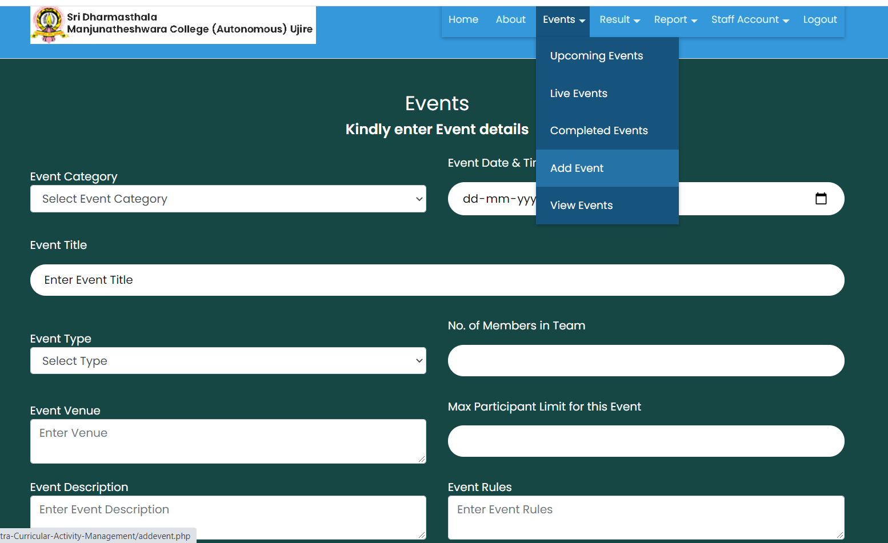
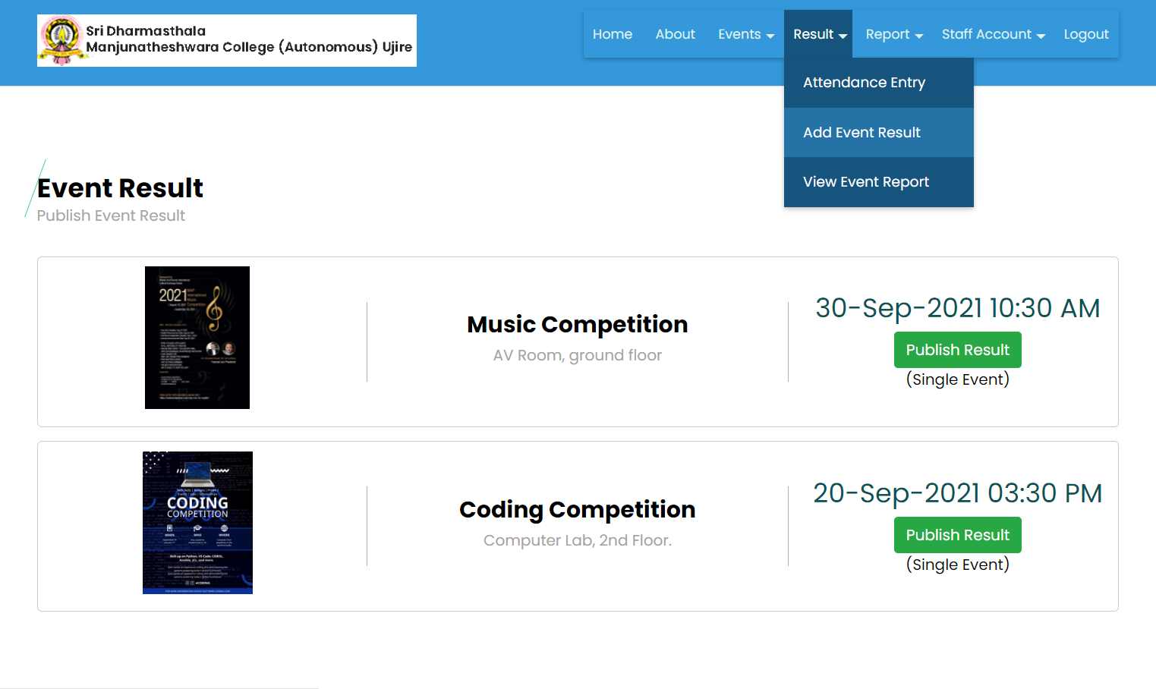
Back

Slide 12
The students can register and login to the system. Once the student login they can give the various events hosted by the staff. If a student wishes to participate in the event they can take part in the events of their department or course.
Registration module: In this module, the students can make the registration by entering all their details along with their course details. Once the student makes the registration they can login using the valid login credentials they have provided at the time of registration.
Event participation module: In this module, student can view the events by individual or team events. Student can view individual or team events. If the student wants to take part in the team event then the student must make the team of 11 members and must enter the token ID of all the team members, only then the student can take part in the team event. In the individual event, the student can view the details of the event such as the scheduled date and rules of events and then the student can participate in the event.
Complaint report module: This module allows students to raise a complaint issue to the staff regarding the event result published. Since the first place, second place and the third place results are verified by the staff, if there is any mistake in the result then the student can complain to the staff for correction and the staff has the authority to accept the complaint or reject it.
Next

Slide 13
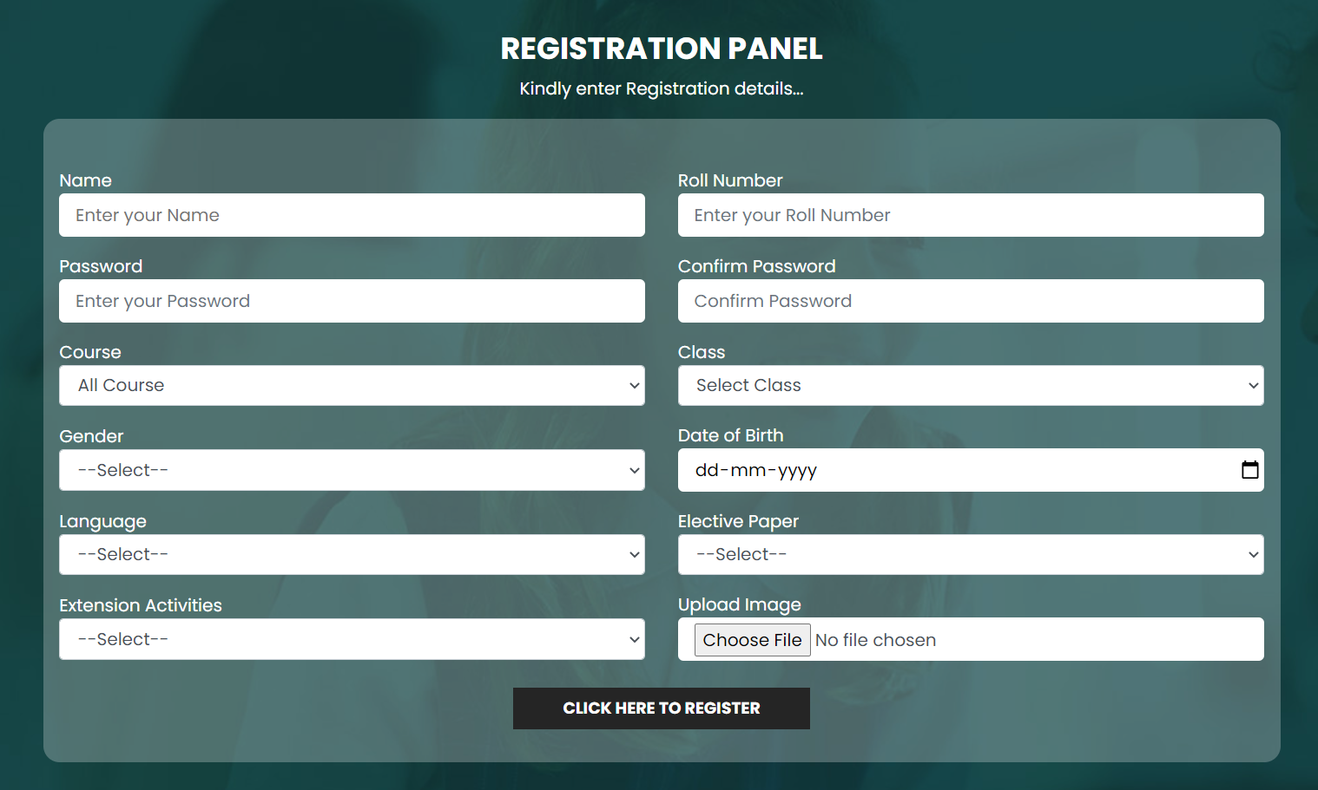
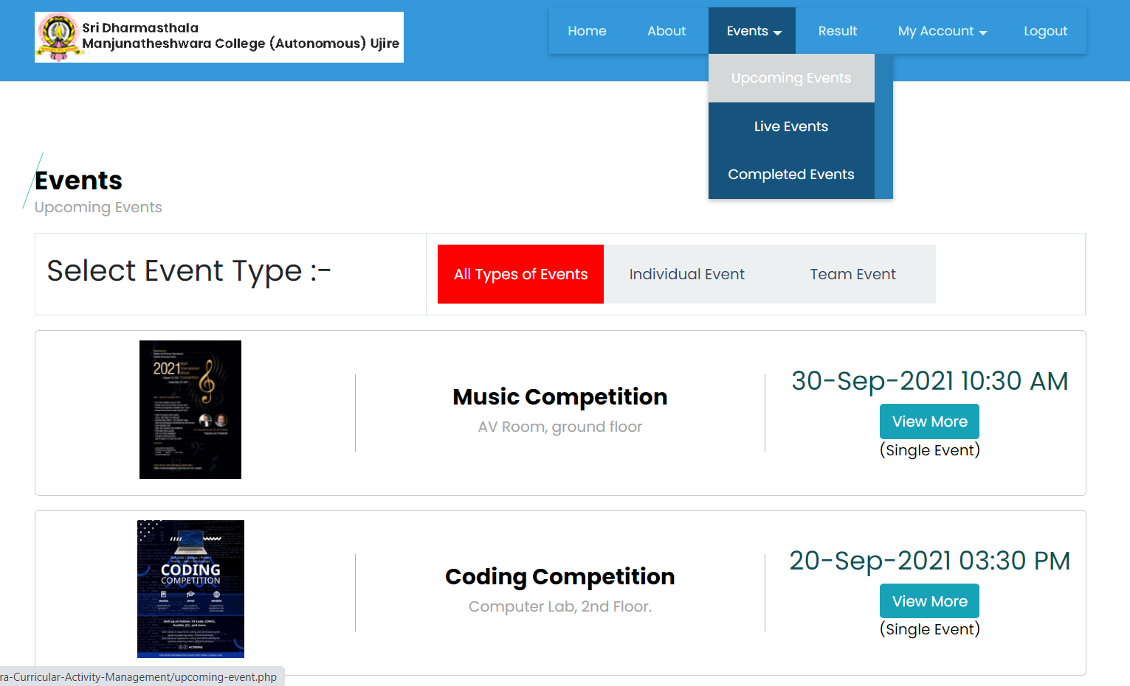
Next

Slide 14
Data flow diagram
The data flow diagram is pictorial representation of the flow of data in the system. Through this diagram the communication between various modules of the system is represented. The data flow diagram is very essential because this will let the developer understand the actual picture of the system. The data flow diagram will tell the developers how the coding of the system must be done. This diagram will connect each and every module to one another and makes the system complete.

Slide 15
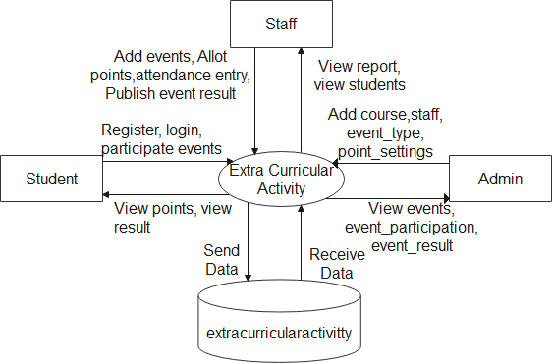
Context flow diagram
Context flow diagram is nothing but the data flow diagram itself. In the context flow diagram, the communication between the system and its various utilities are shown. This diagram shows the relationship of the system in brief. In this diagram the representation of the users of the system with the database of the system is shown.

Slide 16
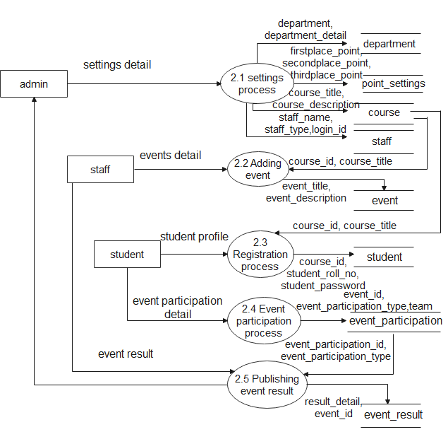
Top Level: DFD (Level 1):

Slide 17
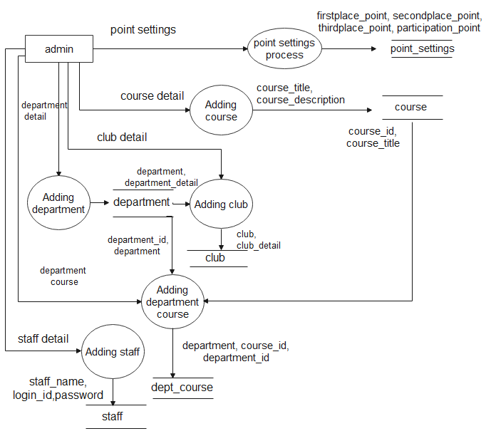
DFD Level 2.1:

Slide 18
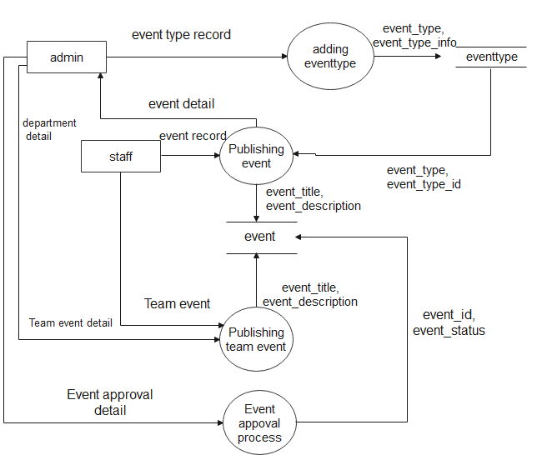
DFD Level 2.2:

Slide 19
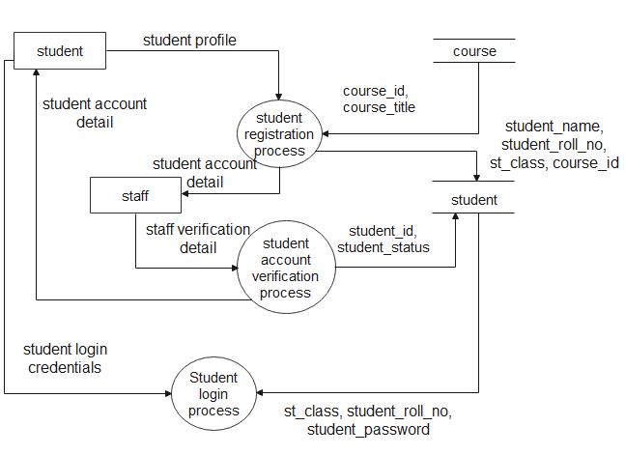
DFD Level 2.3:

Slide 20
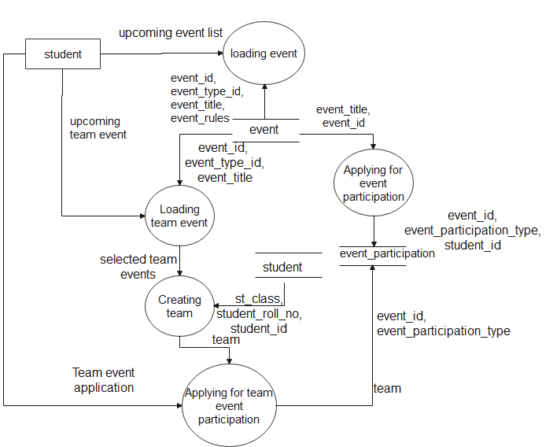
DFD Level 2.4:

Slide 21
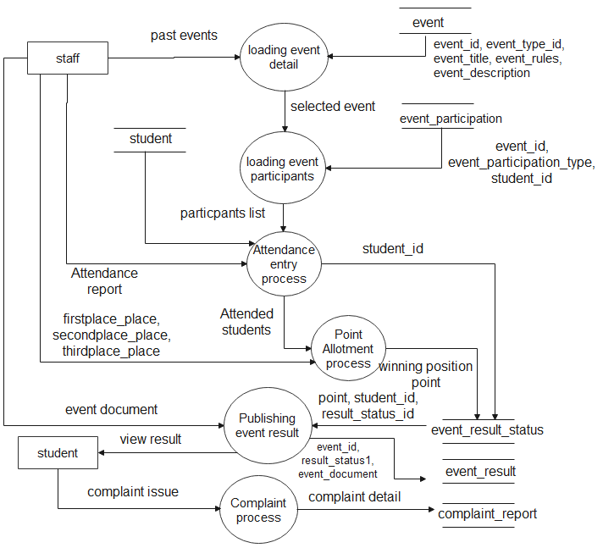
DFD Level 2.5:

